Slide 1


Hulu Online Streaming Service
Jaclyn Huff

Slide 2
Hulu
I never really heard of Hulu until one of my closes friend told me about back in 2014 after my son was born. I must say, it’s still one of my go to apps when I want to watch a good movie or reruns of 2020 , The Doctor or if you feel like a really great cry you can watch like this is Us.

Slide 3
QUESTION1: How have running times changed through the decades?
To answer question 1: I had to analyze the means of each and see how they compared to one another. Nonetheless, after looking at the sample size present in three individual decades I saw that there was quite a large gap, so a classic ANOVA probably would not be the best test to run in these circumstances. So, I did some reviewing and comprehended that a test known as the ‘Kruskal-Wallis’ test for variance when the data is non-parametric, and so that’s the test that I utilized.
The test for both shows and movies came back with the result that there IS a significant difference between run times over the decades.

Slide 4
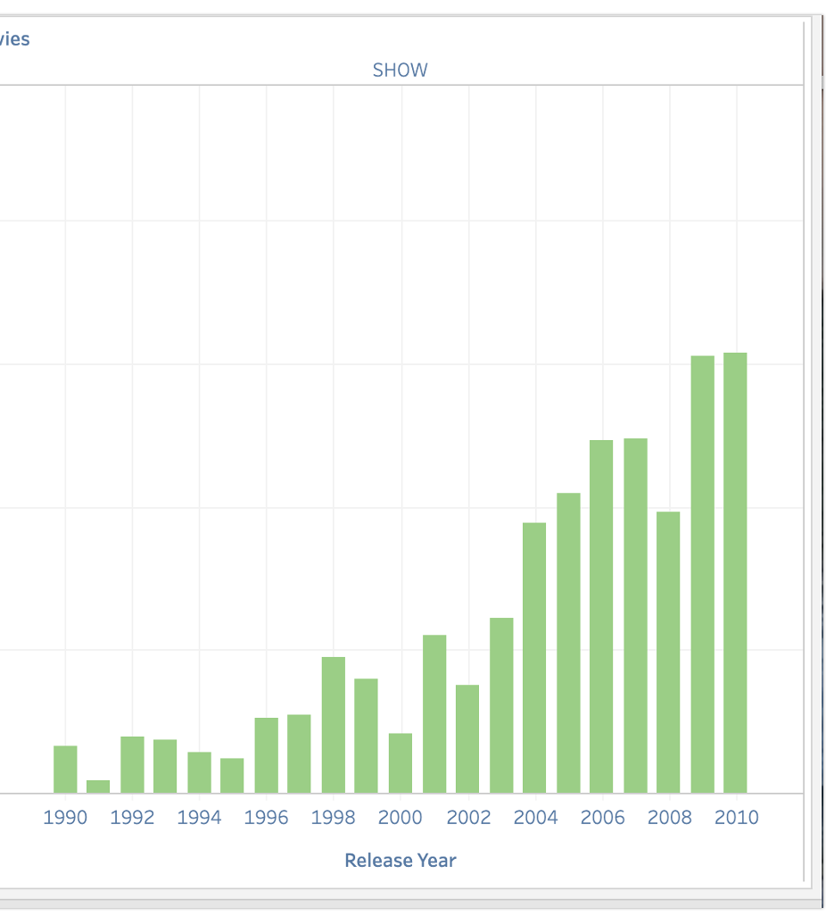
Runtimes Shows for Hulu were shorter in the 1990’s but remained constant for the last two decades.

Slide 5
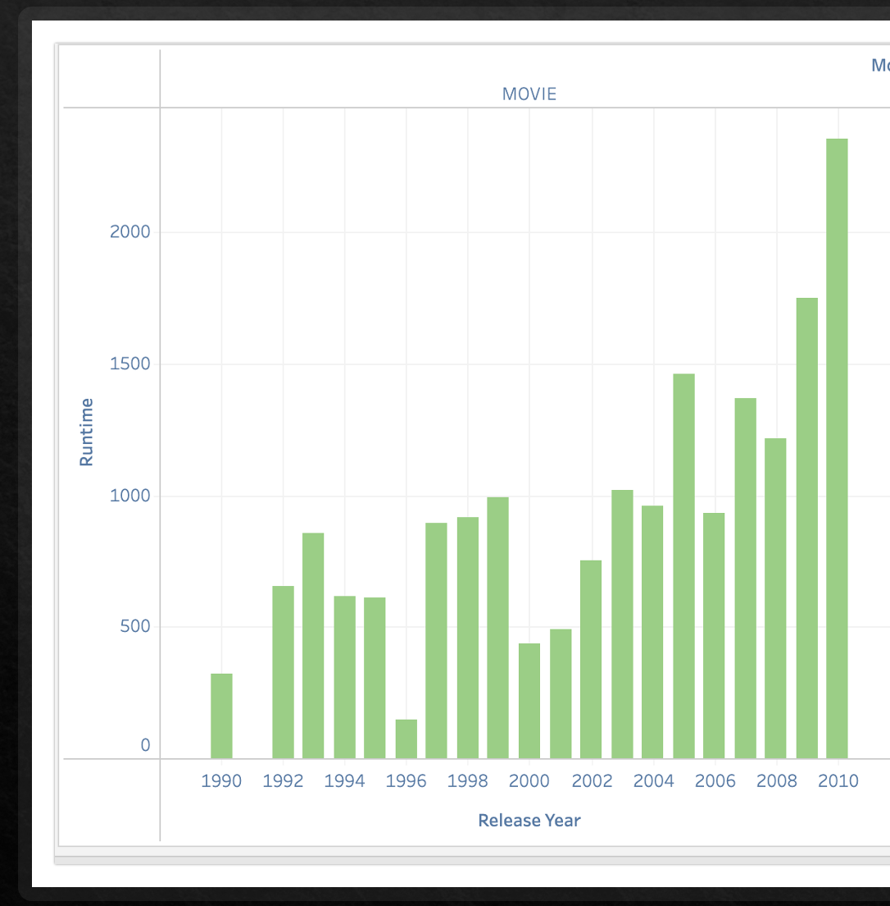
Runtimes Movies for Hulu were longer in the 1990’s and has remained constant

Slide 6
QUESTION 2: Have IMDB ratings changed for movies and shows over the decades? If, so how?
Running the same tests on IMDB scores as I did on runtimes over the decades showed that there is some statistically significant variance to be explored!

Slide 7
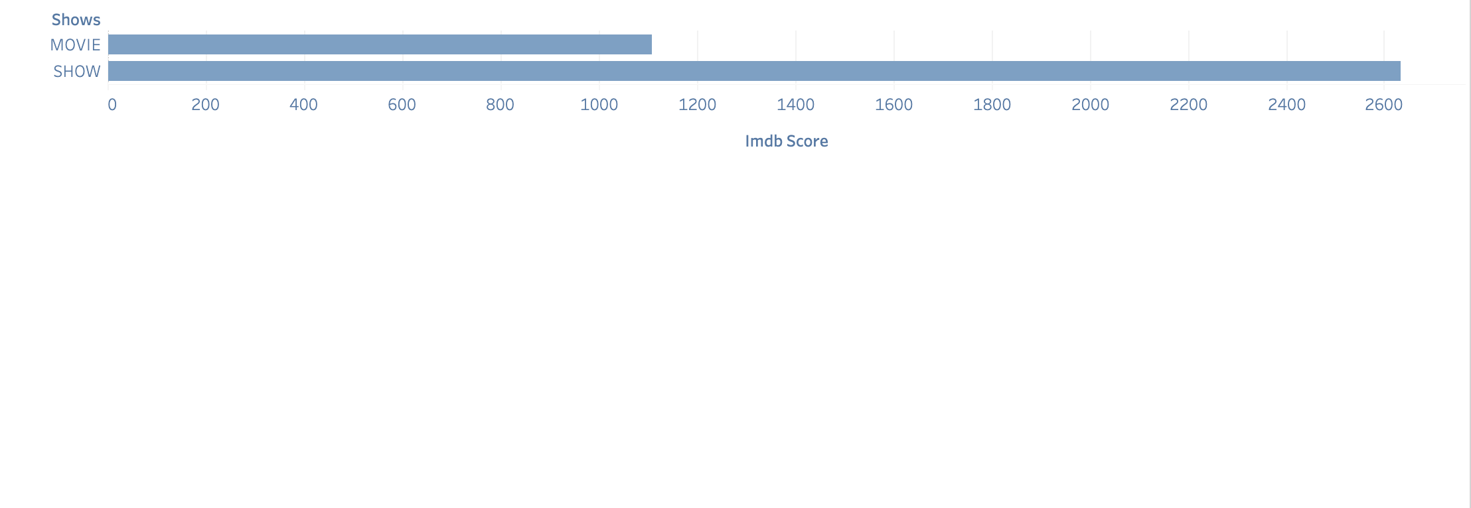

How have IMDB scores changed for shows and movies over the decades?

Slide 8
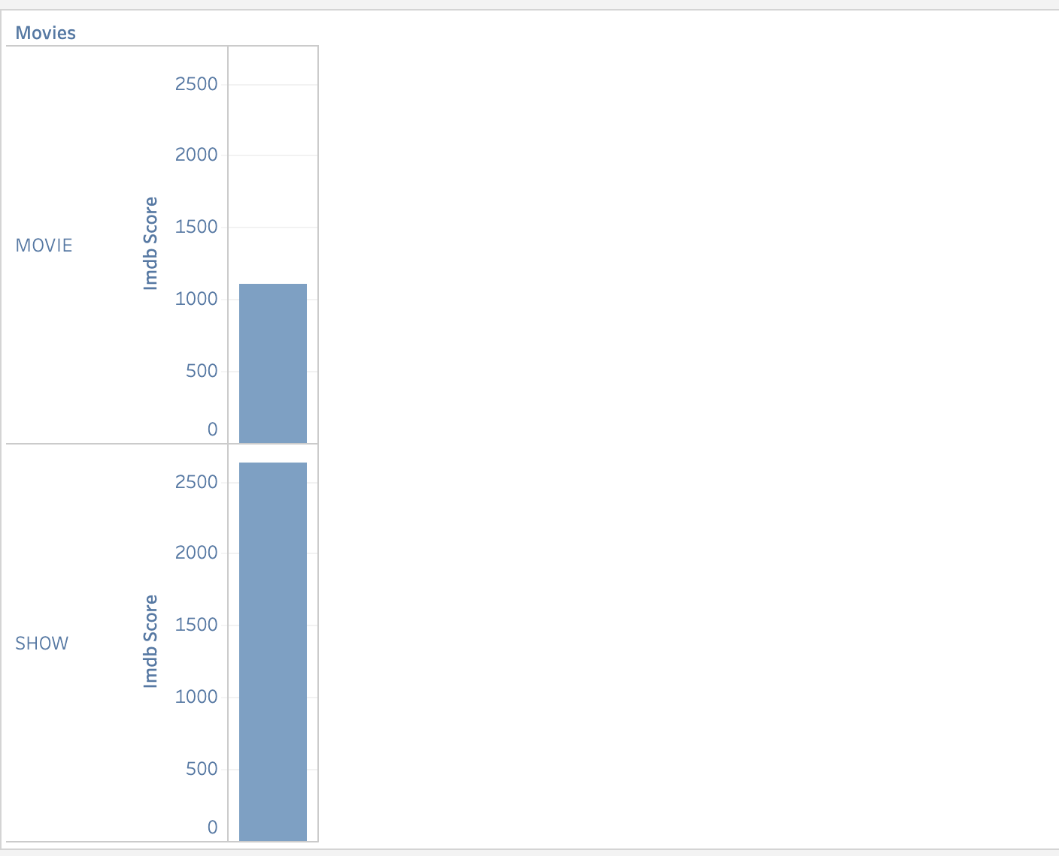
How have IMDB scores changed for shows and movies over the decades?

Slide 9
After running the IMDB Score, it shows that shows are more popular than movies.

Slide 10
After viewing the Dataset, we decided to examine the following three questions
Have movie and show times changed through the decades? If so, how?
Have IMDB ratings changed for movies and shows over the decades? If, so how? And,
How do IMDB scores compare among the various streaming services of Hulu, Netflix, and HBO?

Slide 11
I ran a T-test to see if the average IMDB scores for Hulu were the same as the average IMDB scores for the combined data set. First, I explore movies. The test showed that there IS a significant difference between the overall average IMDB score and the Hulu IMDB score for movies. Next the test for shows revealed that there was NOT a statistically significant difference between the Hulu average and the overall average.
Does Hulu Measure up against HBO and Netflix

Slide 12
Combining the Data Sets
After I had a great understanding of the Hulu data set, I wanted to see how it compared to some of the other major streaming services.
I merged the Hulu data set with a Netflix and HBO data set to make one big streaming services data set.
I took some time to research this new blended data set in R.
Once I discovered the mean IMDB scores for the combined data set for both movies and shows, it was time to compare!

Slide 13
IMDB Comparison
One Sample t-test
For Hulu Shows IMDB_SCORE
t = 4.6823, df = 1249, p-value = 3.147e-06
alternative hypothesis: true mean is not equal to 7
95 percent confidence interval:
7.085988 7.210012
sample estimates:
mean of x
7.148
One Sample t-test
For Hulu Movies IMDB_SCORE
t = -2.1131, df = 981, p-value = 0.03484
alternative hypothesis: true mean is not equal to 6.2
95 percent confidence interval:
6.06075 6.19485
sample estimates:
mean of x
6.1278

Slide 14
Summary
Hulu is the leading online streaming service and comprehensive all I one premium service that offers an expansive slate of live and on demand. Over the past few years Hulu seen to be gaining more subscribers due to it’s live streaming of sports and other movie services it offers.

